Slide 2
Agenda
Overview
What is recommendation system?
Dataset Summary
Hypothesis of project
Machine Learning
Visuals
Conclusion

Slide 3
Overview
Welcome to the Mobile Recommendation System Dataset a comprehensive collection of all smartphones providing valuable insights into all mobile phones categories cutting-edge range of mobile devices. This dataset is a result of meticulous web scraping from trusted source Flipkart.

Slide 4
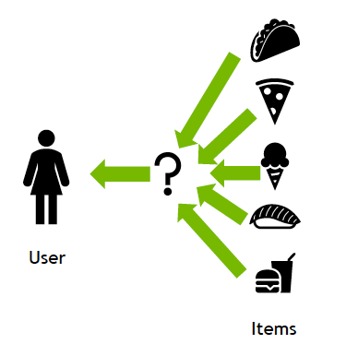
What is a recommendation system?
A recommendation system is an artificial intelligence or AI algorithm, usually associated with machine learning, that uses Big Data to suggest or recommend additional products to consumers. These can be based on various criteria, including past purchases, search history, demographic information, and other factors. Recommender systems are highly useful as they help users discover products and services they might otherwise have not found on their own. Recommender systems are trained to understand the preferences, previous decisions, and characteristics of people and products using data gathered about their interactions. These include impressions, clicks, likes, and purchases. Because of their capability to predict consumer interests and desires on a highly personalized level, recommender systems are a favorite with content and product providers. They can drive consumers to just about any product or service that interests them, from books to videos to health classes to clothing.

Slide 5
Dataset Summary

Slide 6
Hypothesis of project
To create a hypothesis for a project involving a mobile recommendation system, we first need to define the project's objective and scope. Let's assume our project aims to improve user engagement and satisfaction within a mobile app store by enhancing the app recommendation system. Here's a hypothesis statement for this project:
Hypothesis: By implementing a personalized mobile app recommendation system based on user preferences, behavior, and contextual data, we hypothesize that we can significantly increase user engagement metrics, such as app downloads, user retention, and user ratings, leading to a more satisfying and personalized app discovery experience for users.

Slide 7
Machine Learning
In summary, machine learning plays a crucial role in mobile recommendation systems by analyzing user data, content attributes, and contextual information to generate personalized and relevant recommendations.
These systems play a vital role in enhancing user experience, increasing engagement, and driving app usage in the mobile ecosystem.

Slide 11
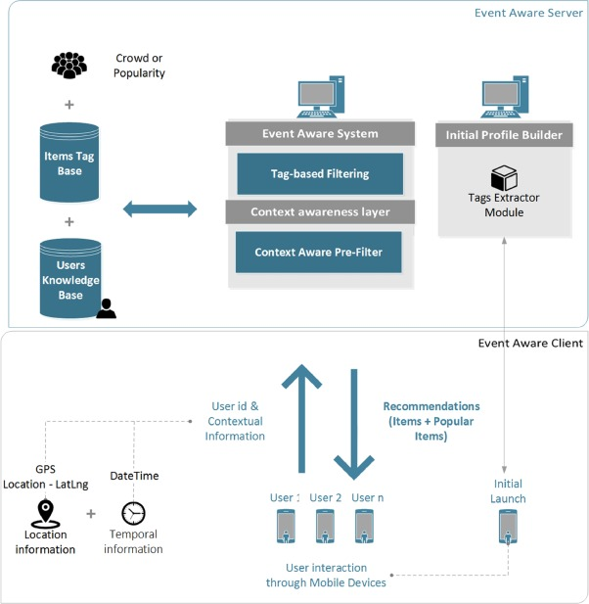
Architecture Of Mobile Recommendation System

Slide 12
Conclusion
In this article we have described in depth EventAware, a mobile recommender system for events. Our proposal integrates a context-aware and a tag-based recommendation algorithm into a mobile application for recommending events. To the best of our knowledge, this is the first mobile recommender system for events. Specifically, we have described the conceptual architecture and the intuitive user interface with an attractive design that enhances user experience. Moreover, EventAware initializes

Slide 13
Thank you

